Slide 1


VISVESVARAYA TECHNOLOGICAL UNIVERSITY, BELAGAVI
BLDEA’S V.P. Dr. P.G. HALAKATTICOLLEGE OF ENGINEERING AND TECHNOLOGY, VIJAYAPUR
586 103
DEPARTMENT OF CSE
(Artificial Intelligence and Machine Learning)
V Semester
MINI-PROJECT ON
“HEART DISEASE PREDICTION”
Presented By
Ms. Neha Nala(2BL22CI028)
Mr. Shubham Kaddu(2BL22CI051)
Under the Guidance
Prof. Sunanda S Alur
2024-2025

Slide 2
Table of contents
Abstract
Introduction
Objectives
Methodology
Model Selection
Model Evaluation
Building a Predictive System
Conclusion

Slide 3

Heart Disease Prediction
Heart disease is a significant public health concern, affecting millions worldwide. Early detection and intervention are crucial for improving patient outcomes.
This presentation explores the development and evaluation of a machine learning model designed to predict heart disease based on medical data.
This model employs logistic regression, a powerful and interpretable algorithm for binary classification tasks, to classify individuals as having or not having heart disease.
One person dies every 33 seconds from cardiovascular disease.
In 2022, 702,880 people died from heart disease. That's the equivalent of 1 in every 5 deaths.

Slide 4

Objectives
1
Accurate Prediction
2
Performance Evaluation
The primary objective is to develop a robust machine learning model that accurately predicts the likelihood of heart disease in individuals based on their medical data.
The model's performance will be rigorously evaluated using standard metrics such as accuracy, precision, recall, and F1-score to ensure its effectiveness.
3
User-Friendly Interface
The model will be integrated into a user-friendly system designed for healthcare professionals, providing a simple and intuitive interface for inputting patient data and receiving prediction results.

Slide 5
Methodology
Feature Selection
Data Splitting
The medical features, excluding the target variable, are chosen as independent variables (X). The target variable, indicating the presence or absence of heart disease, serves as the dependent variable (Y).
The dataset is divided into training and testing sets using stratified sampling. The training set constitutes 80% of the data, while the remaining 20% is used for testing. This ensures a balanced representation of the target variable in both sets.

Slide 6
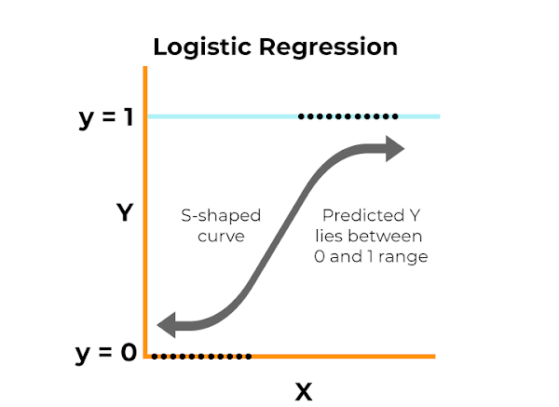
Model Selection
Logistic Regression
Advantages
Logistic regression is a statistical method used to predict the probability of a binary outcome (heart disease present or absent) based on a set of independent variables.
Logistic regression is chosen for its simplicity, interpretability, low computational cost, and suitability for datasets with linear decision boundaries.
It provides interpretable coefficients that quantify the relationship between each feature and the likelihood of heart disease.

Slide 7
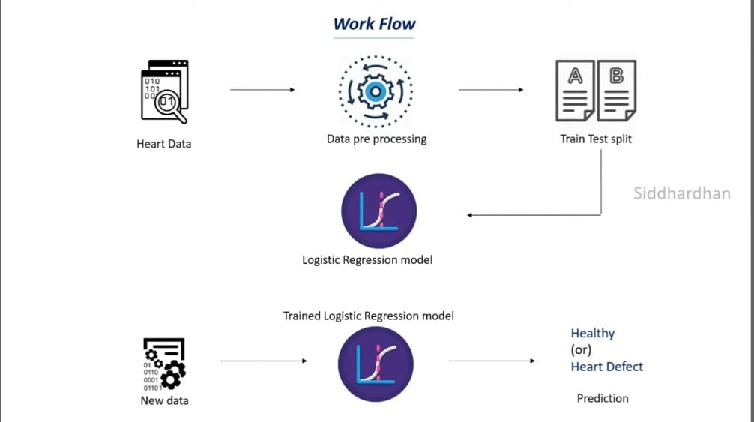
Model Evaluation
After training, the model's performance is evaluated on both the training and test datasets. The accuracy score, which represents the percentage of correct predictions, is used to assess the model's ability to generalize to unseen data. High accuracy on both datasets indicates that the model is not overfitting and has learned meaningful patterns from the data.

Slide 8
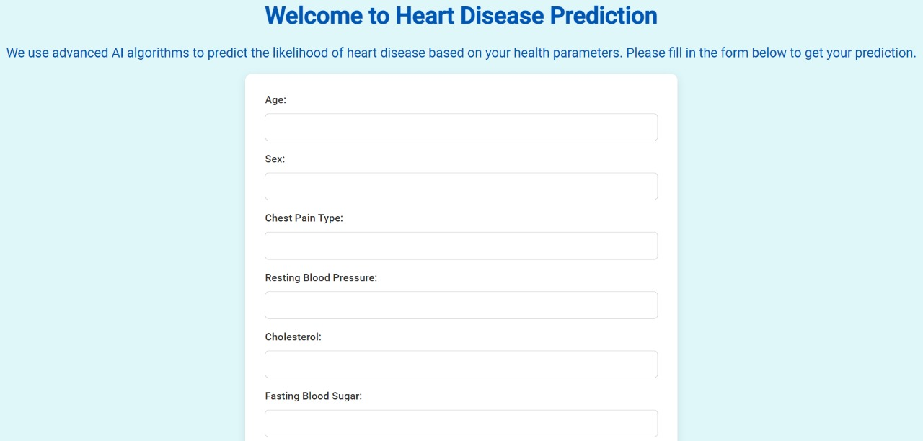
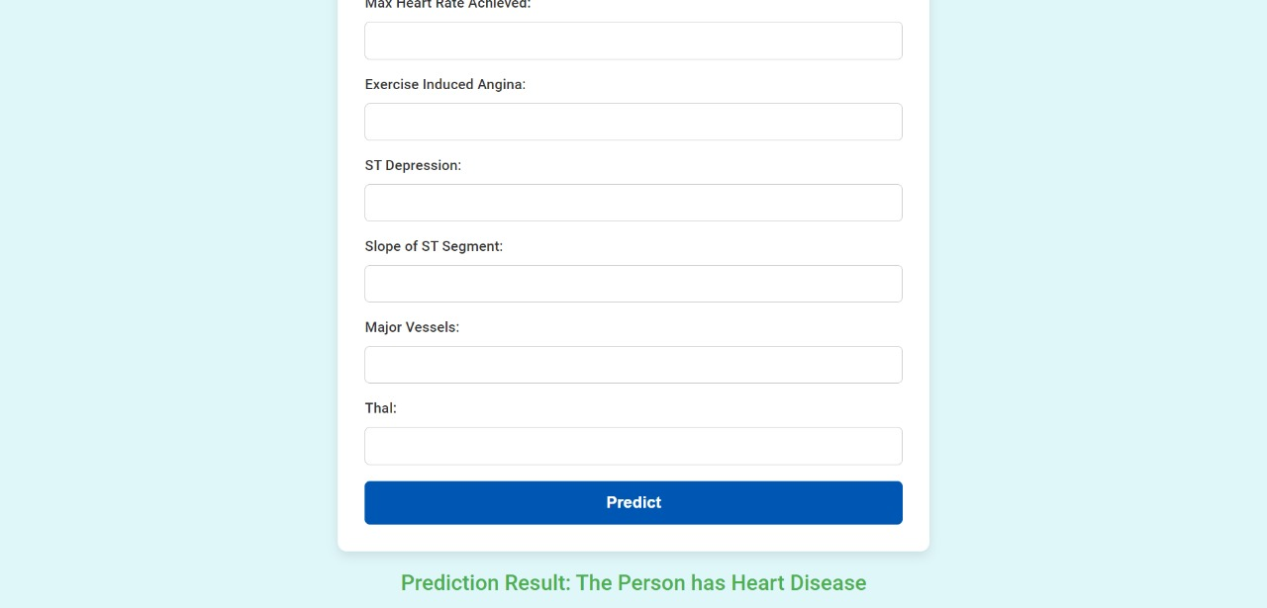
Building a Predictive System
The trained model is integrated into a user-friendly predictive system. Healthcare professionals can input a new patient's medical data into the system, and the model will generate a prediction indicating the likelihood of heart disease. The system provides a simple and intuitive interface for easy use and interpretation of results.

Slide 9
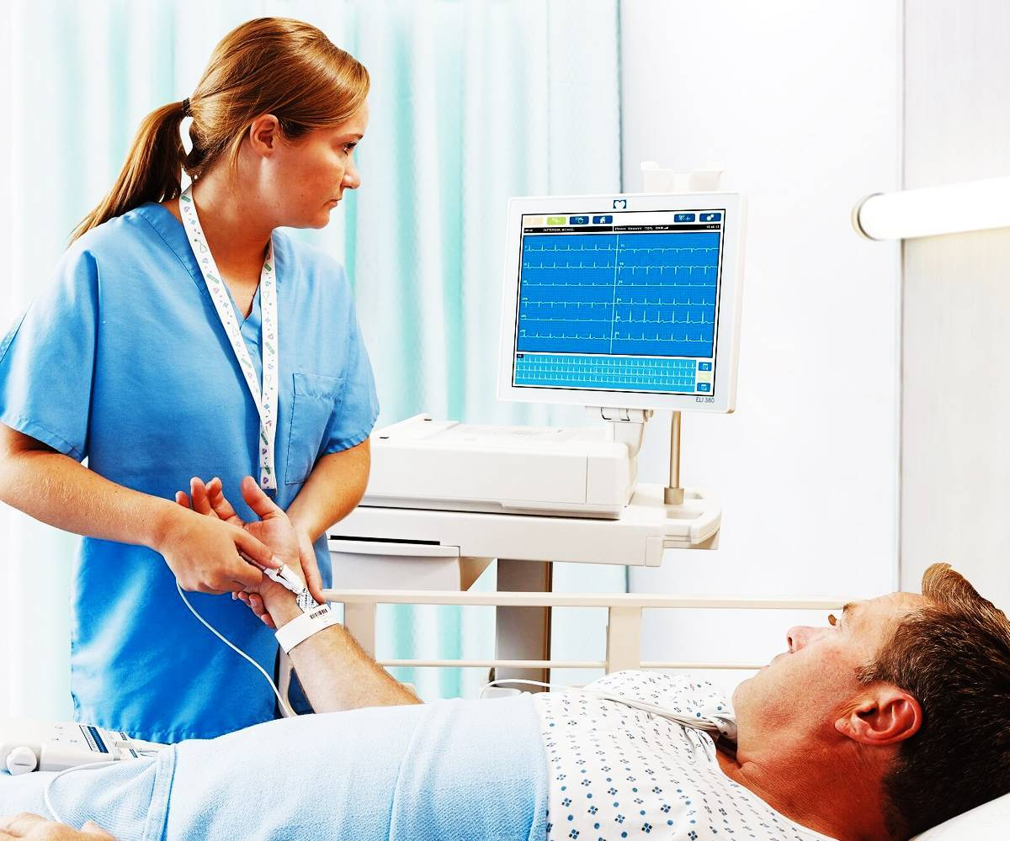
Conclusion
This project demonstrates the effective use of machine learning, specifically logistic regression, for heart disease prediction. The model achieves high accuracy and provides interpretable insights into the factors influencing heart disease risk. This system has the potential to be a valuable tool for early detection, allowing healthcare professionals to intervene promptly and improve patient outcomes. Further research and development can enhance the model's capabilities by incorporating additional features, exploring advanced algorithms, and integrating the system into real-time health monitoring applications.

